Slide 1
Poems and Early Child Language Development
Zhen Jiang
May 13, 2020

Slide 2
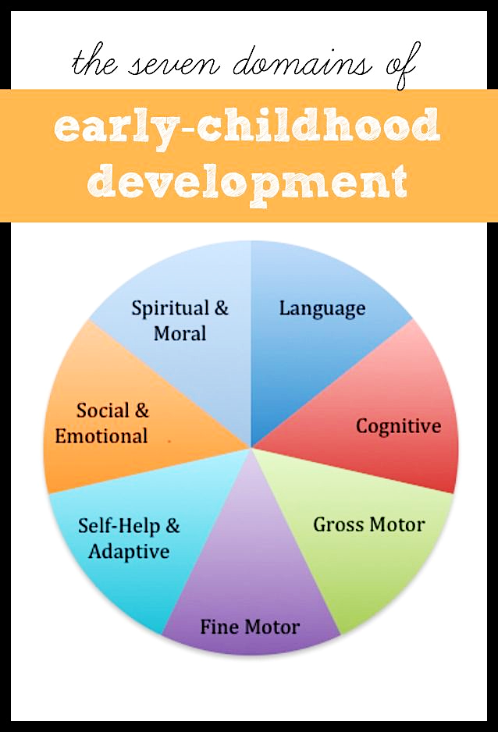
Introduction
Poetry
Effective: simplicity and brevity of thought.
Helps children pay attention to the patterns of language & encourages vocabulary.
Aims
Emphasis on teaching
Provide suggestions for early child language educator regarding
Diff. between genders
Emotional change

Slide 3
Dataset
Poki Dataset (11MB)
https://github.com/whipson/PoKi-Poems-by-Kids/blob/master/README.md
Variable Name | Means
id | unique identifier for each poem
grade | school grade (1-12)
author | first name of author
valence | Means valence
arousal | Means arousal
dominance | Means dominance
anger | Means anger
fear | Means fear
sadness | Means sadness
joy | Means joy
total words | total number of non stop words within poem
gender | probable gender based on author name
A corpus of 61,330 poems.
Written by children from grades 1 to 12.
Especially useful in studying child language.
Emotional words:
Scored by intensity analyzed by the NRC Emotion Intensity lexicon.

Slide 4
Data Analysis
Aim 1
Visualize change in the total number of words in a poem
View by gender
Figure 2
Figure 1

Slide 5
Data Analysis
Figure 3
Aim 2
Visualize the amount of submitted poems
Grade 4 ~ 6: more active poem writers.
Grade 3: increased dramatically.
Grade 8: dropped obviously.
Gender: female submitted more poems.

Slide 6
Data Analysis
Figure 4
Aim 3
Visualize the trends of emotional change

Slide 7
Summary
Children from grade 3 start to develop more interest in writing poems.
Female show more interest at writing poems than males do.
Grade 3: More emphasis on language education.
Efficiently develop language skills.
When children grow up:
Ability of writing longer poems is improved.
Words usage to express emotion is changed as well.
Improved ability of manipulating language (vocabulary) as children grow up.

Slide 8
Thanks for your attentions!

